Slide 1
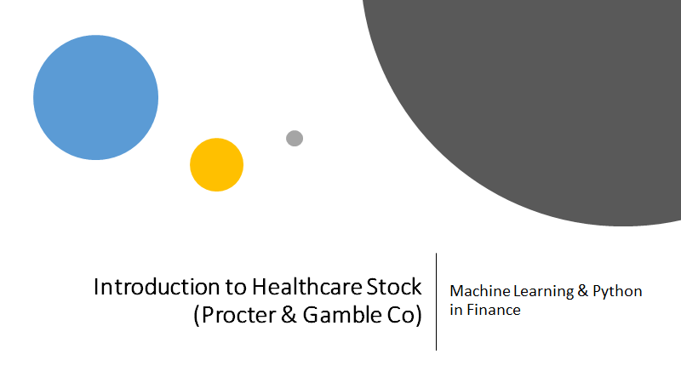
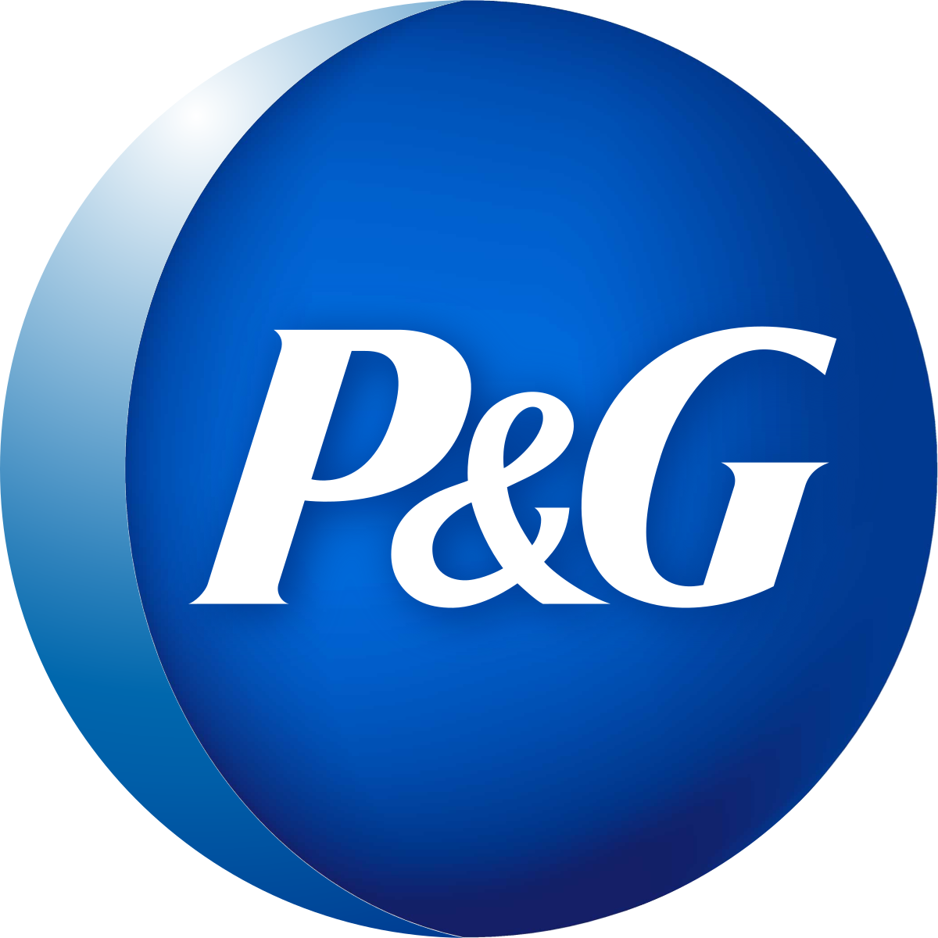
Name:
Parth Rana
Shaishav Shah
Supriya Murty
Anshul Balamwar

Slide 2
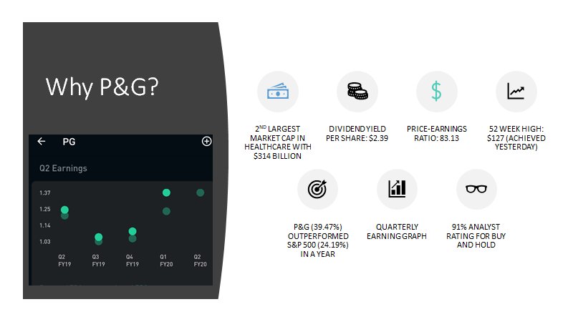

Slide 3
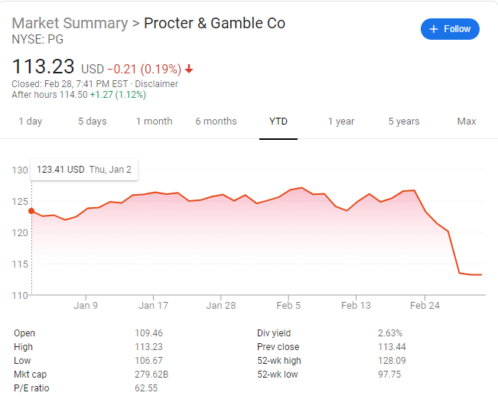
PG Stock- Past Return Index
Year to date stock
Current P/E ratio higher than SP500-HC
High Revenue generating company regardless of current financial strain
Notes:
2 min short introduction on the past and present of the asset you trade. Demonstrate your deep understanding about the market.

Slide 4
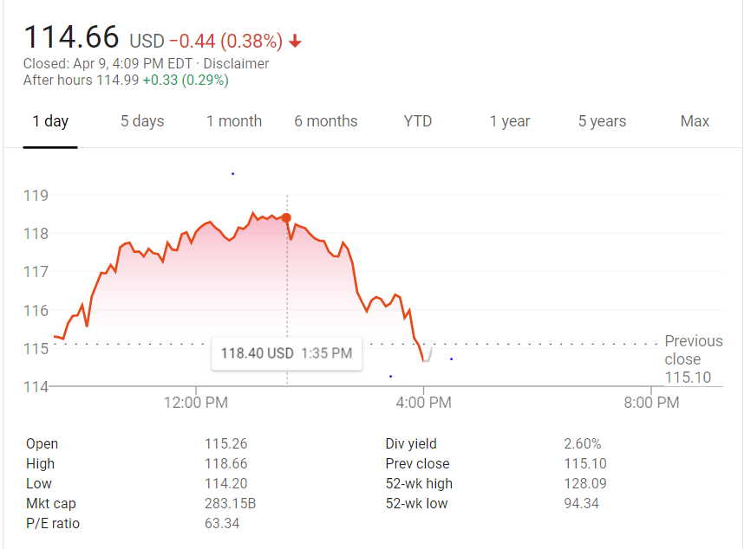
PG Stock Present Return Index
Even with the current COVID-19 situation we can see that the company was expected to post earnings of $1.24 per share and it actually produced earnings of $1.37 per share, delivering a surprise of 10.48%.
Even with the drop in the price index by 38% the P&G market is still stable and is considered as top 10 company in Healthcare sector

Slide 5
DATA
To begin with we are considering P&G stock prices for at most 20 years, ranging from 2000 to 2019
Data Definition:
Date: Date of trading day
High: Highest Price of Stock on that day
Low: Lowest Price of Stock on that day
Open: Opening Price of Stock on that day
Close: Closing Price of Stock on that day
Volume: Number of shares or contracts traded in a security or an entire market during a given period of time
Adj Close: Adjusted closing price amends a stock's closing price to accurately reflect that stock's value after accounting for any corporate actions

Slide 6
S&P-500 and S&P-500 HealthCare Sector
S&P 500- The S&P 500, or just the S&P is a stock market index that measures the stock performance of 500 large companies listed on stock exchanges in the United States. It is one of the most commonly followed equity indices, and many consider it to be one of the best representations of the U.S. stock market.
To see how P&G stock prices correlate with S&P 500 Health Care Sector data
HC-Open- Cumulative opening price of all HealthCare stocks on that day.
HC-Close- Cumulative closing price of all HealthCare stocks on that day.
HC- High- Cumulative high price of all the HealthCare stocks on that day.
HC-lOW- Cumulative low price of all the HealthCare stocks on that day.
To see how P&G Stock prices correlate with S&P 500 Data
S&P Open- Cumulative opening price of all S&P 500 stocks on that day.
S&P Close - Cumulative closing price of all S&P 500 stocks on that day.
S&P High- Cumulative high price of all the S&P 500 stocks on that day.
S&P Low- Cumulative low price of all the S&P 500 stocks on that day.

Slide 7
Fama French Factor Model
Fama French Model is an asset pricing model that expands on the capital asset pricing model (CAPM) by adding size risk and value risk factors to the market risk factor in CAPM.
Mkt-RF: MKTRF (or Rm-Rf) is the excess return on the market. It is calculated as the value-weight return on all NYSE, AMEX, and NASDAQ stocks (from CRSP) minus the one-month Treasury bill rate (from Ibbotson Associates)
SMB: Small Minus Big (S M B) is the average return on the small portfolios minus the average return on the big portfolios. It is basically the portfolio returns
HML: High Minus Low (H M L) is the average return on the value portfolios minus the average return on the growth portfolios
RF: This is just Risk Free interest you can get(Like treasure bills or say basic checking account returns as an example)
RMW: Difference between the returns of firms with robust (high) and weak (low) operating profitability.(Probability factor)
Notes:
SMB (Small Minus Big) = Historic excess returns of small-cap companies over large-cap companies
HML (High Minus Low) = Historic excess returns of value stocks (high book-to-price ratio) over growth

Slide 8
ADS Index
ADS-Index-The Aruoba-Diebold-Scotti business conditions index is designed to track real business conditions at high observation frequency. The average value of the ADS index is zero.
Progressively bigger positive values indicate progressively better-than-average conditions, whereas progressively more negative values indicate progressively worse-than-average conditions. The ADS index may be used to compare business conditions at different times.

Slide 9
P&G Competitors Data
We considered these companies because firstly they belong to the same business sector i.e HealthCare and are mainly into consumer goods
Procter & Gamble is a very well-known consumer products company, owning major brands like Crest, Gillette, Pampers, and Tide.
Major competitors for P&G include Colgate-Palmolive, Church and Dwight, and Unilever.
Nearly two-thirds of P&G’s revenues are generated from developed markets, while Unilever and Johnson & Johnson gets the majority of its revenues from faster-growing emerging markets.
CL is much smaller than PG, though — Colgate has amassed $62 billion in market capitalization vs. $220 billion for Procter & Gamble. However, I think the smaller size is beneficial to Colgate for many of the same reasons large size hurts Procter & Gamble: oversight and control of the business by management.
Procter & Gamble (PG +0.5%) is in talks with Pfizer (PFE +0.3%) over a purchase of the company's consumer products business or a joint venture arrangement as both belong to the same market domain

Slide 10
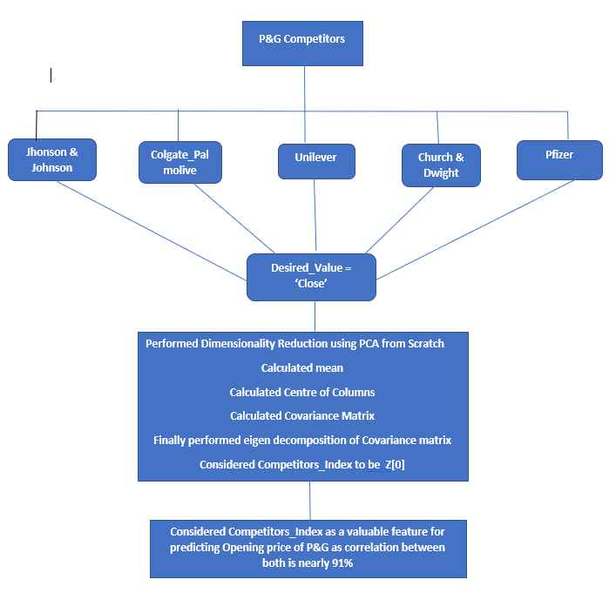

Slide 11
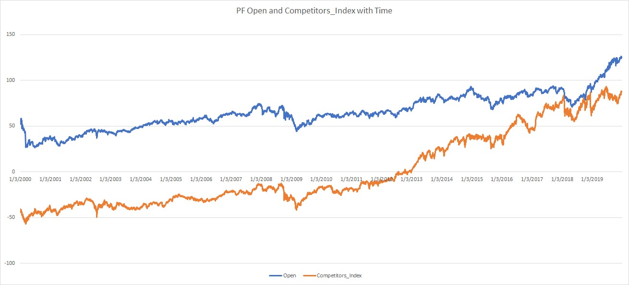
Notes:
Competitors_Index is considered useful for predicting the Open for the next day because the correlation between these two features was approximately 91%

Slide 12
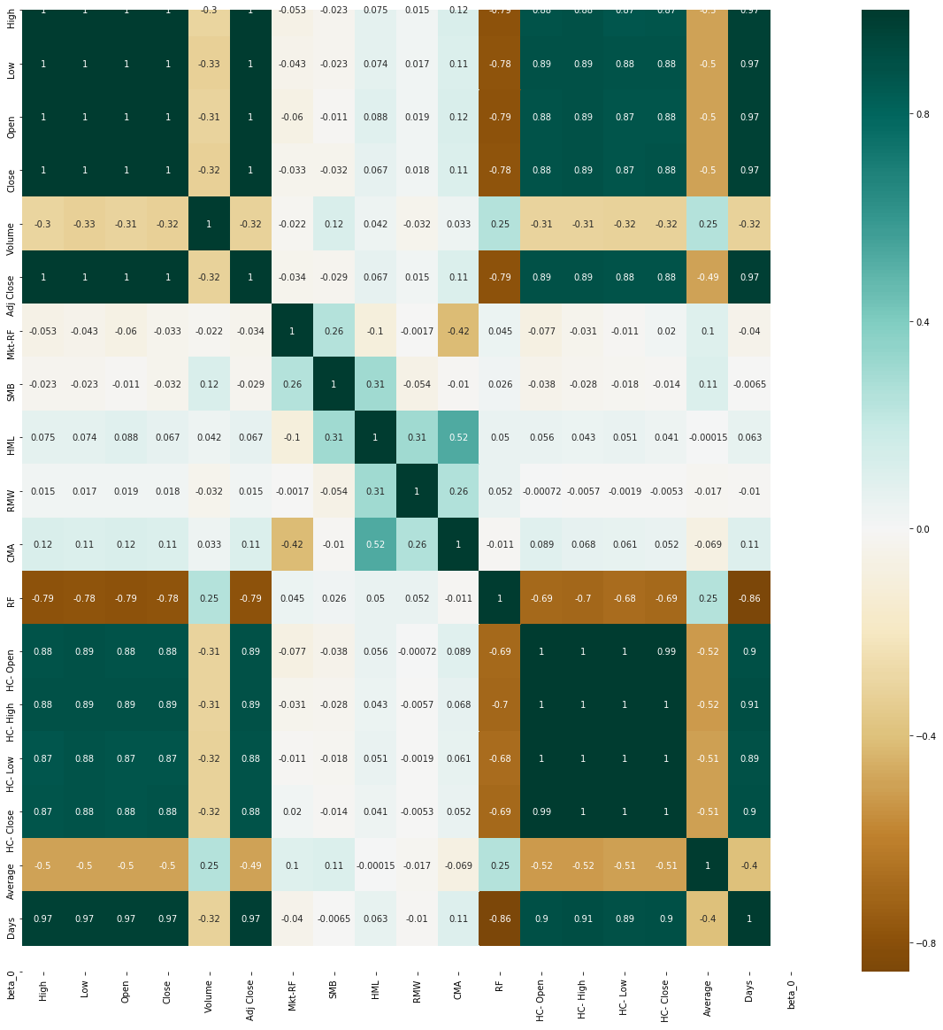
EXPLORATORY DATA ANALYSIS
Notes:
Correlation Matrix between all the features that we have considered for PG Stock
Dark color represents max correlation between the features whereas the lighter colors represent minimum correlation.

Slide 13
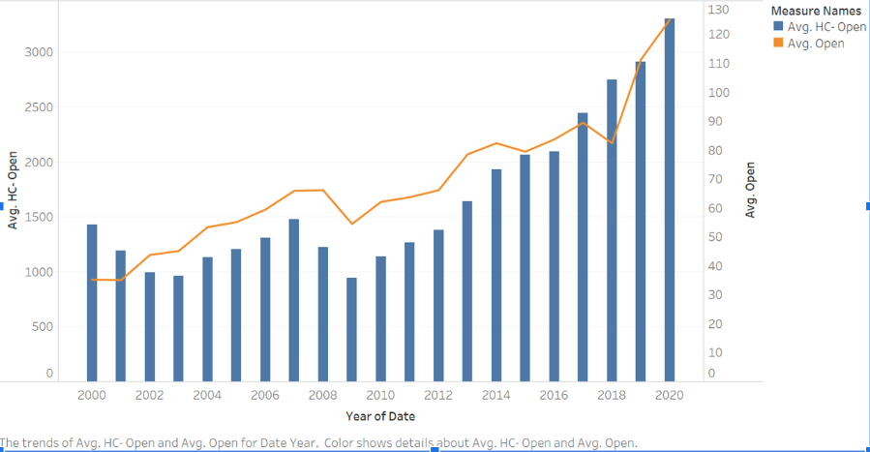
Graph Representing AVG Open of S&p 500 with AVG Open of P&G Stock

Slide 14
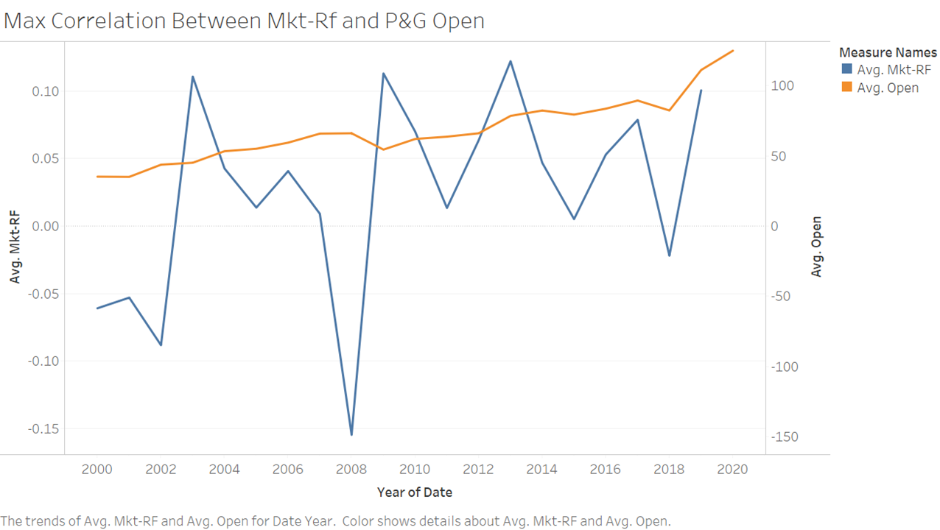

Slide 15
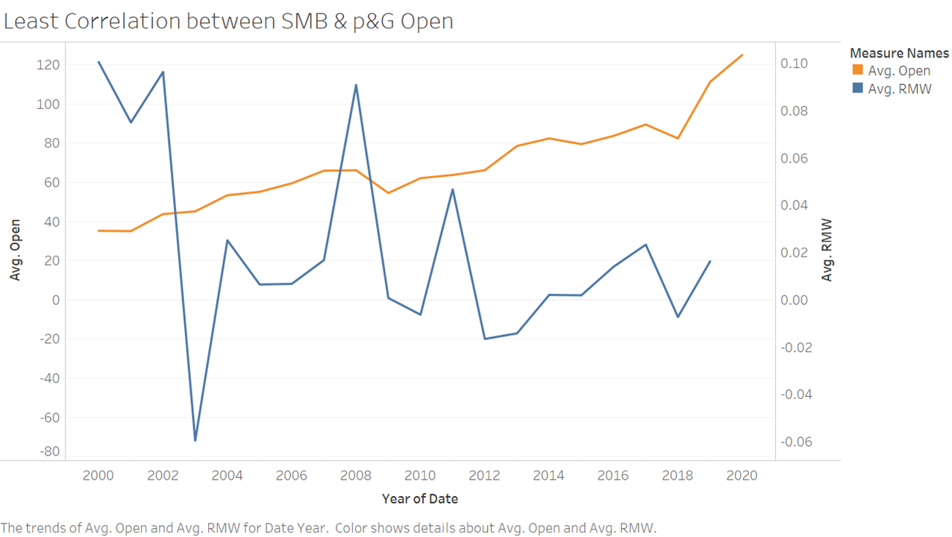

Slide 16
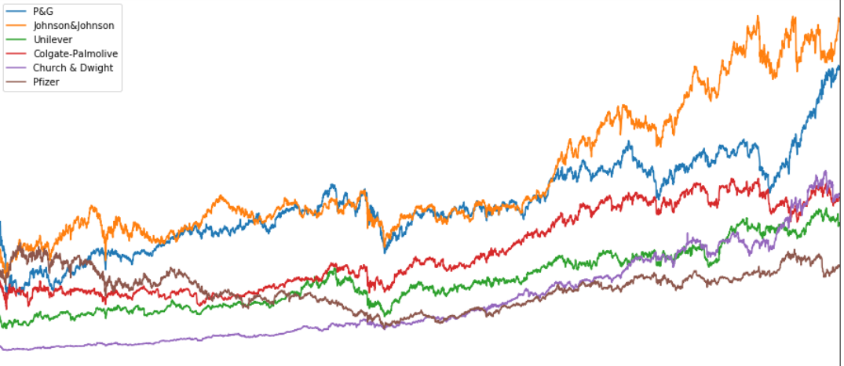
Graph Representing the Opening Price of P&G with their Competitors

Slide 17
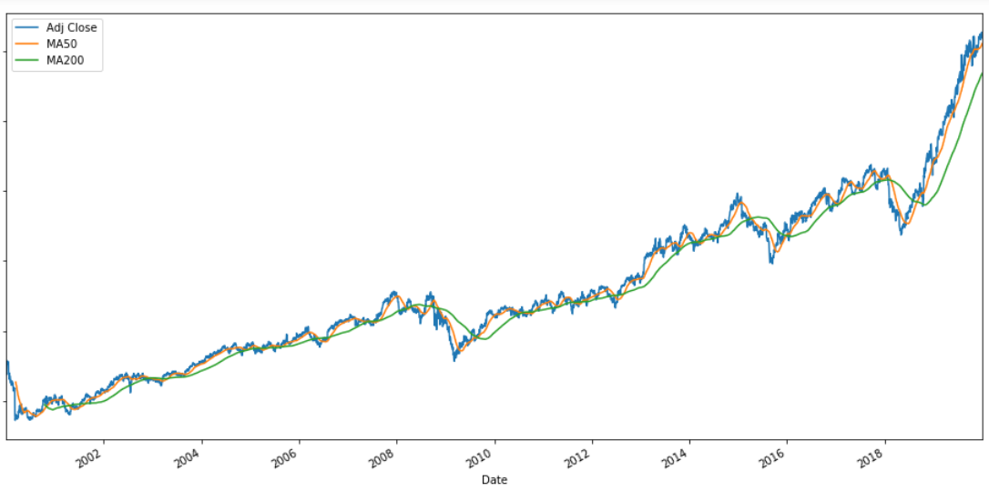
Moving average- between the rolling period of 50 and 200 days
Notes:
#Moving Average Visualization
PG['MA50']=PG['Adj Close'].rolling(50).mean()
PG['MA200']=PG['Adj Close'].rolling(200).mean()
PG[['Adj Close','MA50','MA200']].plot(label='P&G',figsize=(16,8));

Slide 18
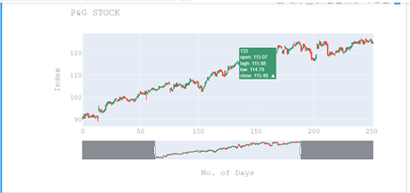
CandleStick Visualization

Slide 19
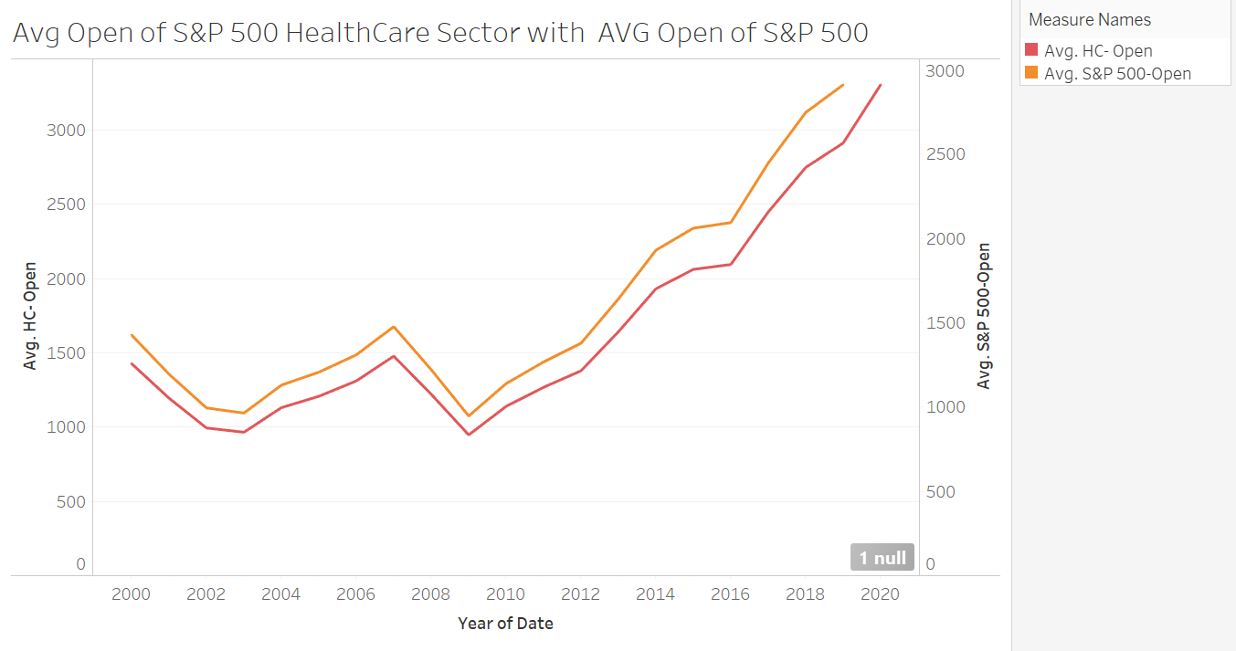

Slide 20
Machine Learning Models and Strategies
Linear Regression
Linear Regression with PCA
Random Forest Algorithm
Time Series Forecasting ARIMA model
Pairs Trading Algorithm
Garch Model
Long Short Term Memory (RNN)

Slide 21
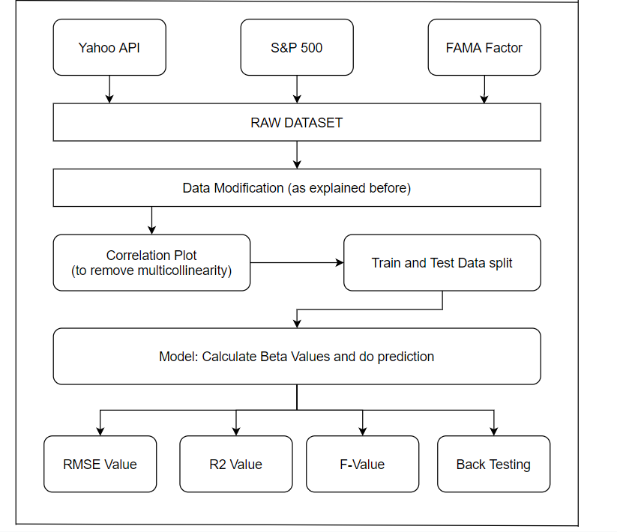
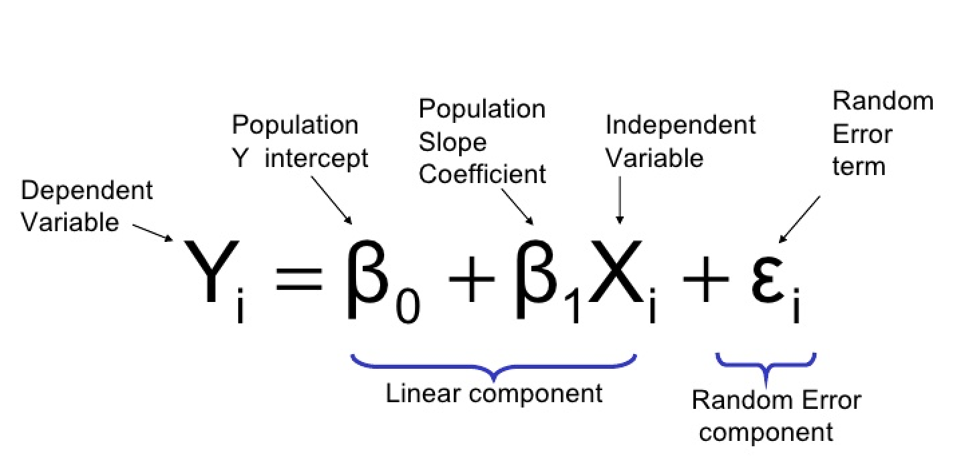
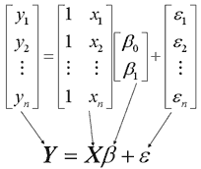
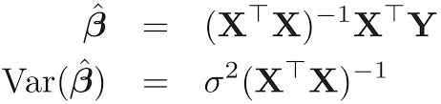
Linear Regression
Definition: Linear regression is a linear approach to modeling the relationship between a dependent variable and one or more independent variables
Equations:

Slide 22
Assumptions: Multiple linear regression analysis makes several key assumptions:
There must be a linear relationship between the outcome variable and the independent variables. Scatterplots can show whether there is a linear or curvilinear relationship.
Multivariate Normality–Multiple regression assumes that the residuals are normally distributed.
No Multicollinearity—Multiple regression assumes that the independent variables are not highly correlated with each other. This assumption is tested using Variance Inflation Factor (VIF) values.
Homoscedasticity–This assumption states that the variance of error terms are similar across the values of the independent variables. A plot of standardized residuals versus predicted values can show whether points are equally distributed across all values of the independent variables.

Slide 23
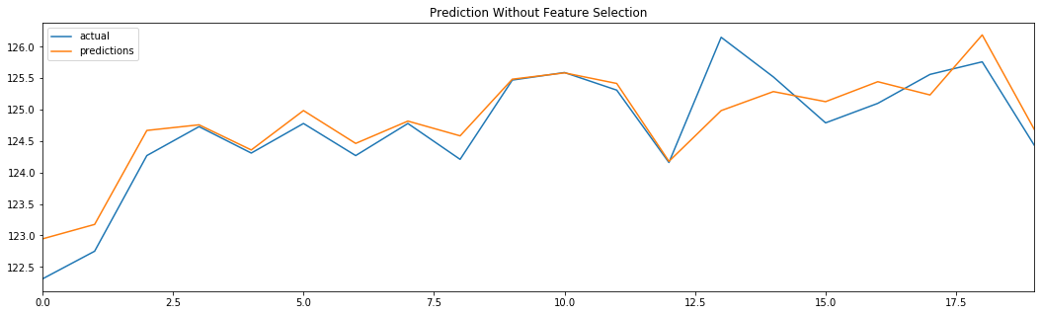
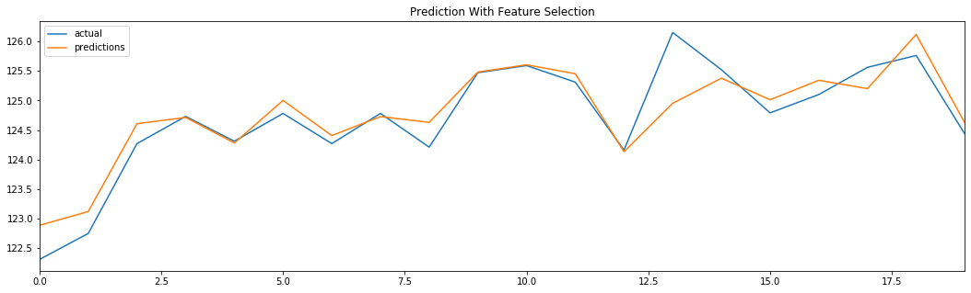

Slide 24
Results and Outputs
Accuracy | Linear Regression Model (w/o feature Selection) | Linear Regression Model (with feature Selection)
RMSE Value | 0.3858 | 0.3680
R2 Value | 0.8270 | 0.8426
F Value | 3.466 | 16.212
Sharpe Ratio | 1.17
Treynor Ratio | 1.83
Profit (%) | 0.5792%
Hit Rate | 1.0

Slide 25
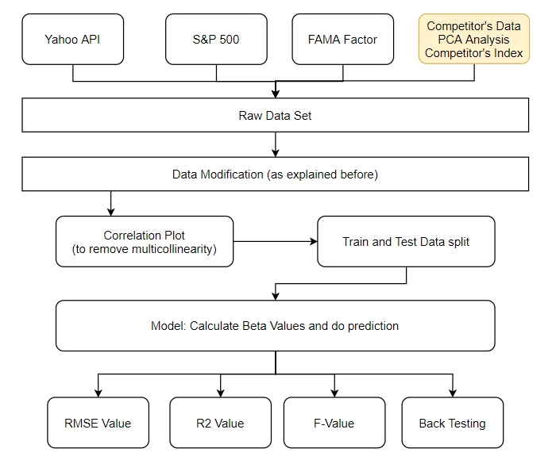
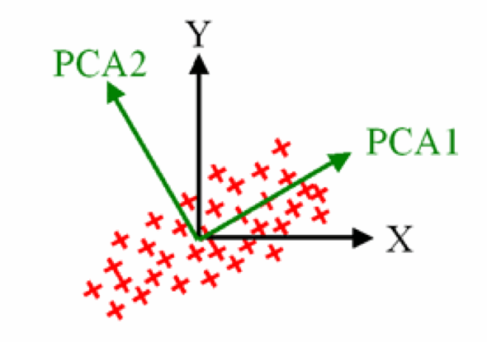
Linear Regression With PCA
PCA: Principal component analysis (PCA) is a technique used for identification of a smaller number of uncorrelated variables known as principal components from a larger set of data. PCA is a standard technique for visualizing high dimensional data and for data pre-processing. PCA reduces the dimensionality (the number of variables) of a data set by maintaining as much variance as possible.

Slide 26
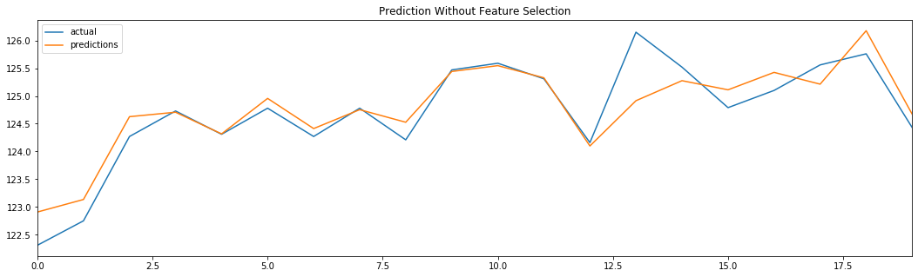
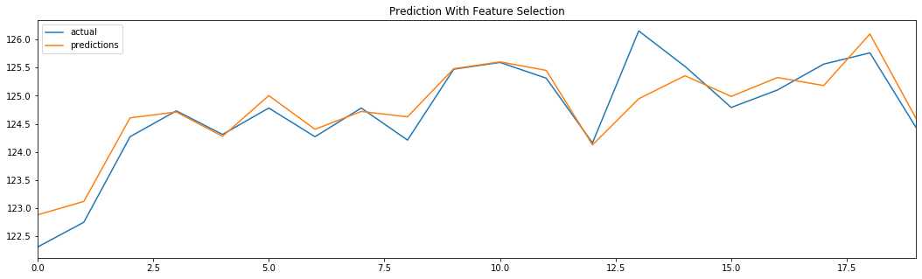

Slide 27
Results and Outputs
Accuracy | Linear Regression Model (w/o feature Selection) | Linear Regression Model (with feature Selection)
RMSE Value | 0.3834 | 0.3669
R2 Value | 0.8292 | 0.8436
F Value | 2.843 | 12.060
Sharpe Ratio | 1.16
Treynor Ratio | 1.84
Profit (%) | 0.5764%
Hit Rate | 1.0

Slide 28
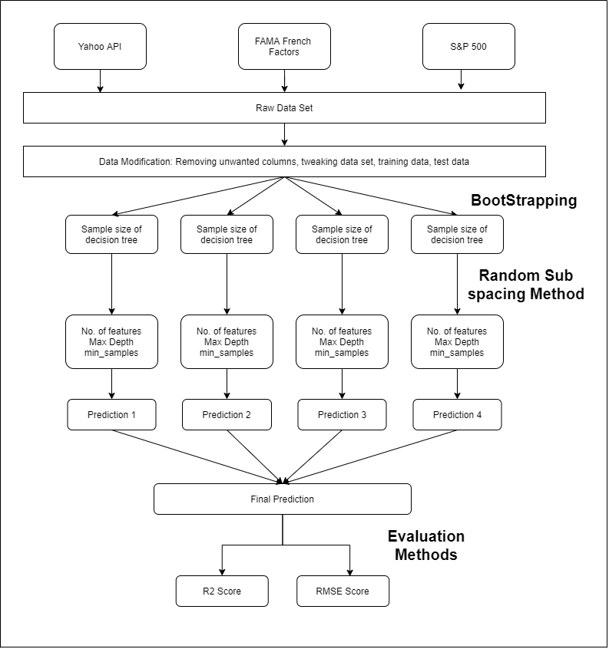
Random Forest Algorithm
Definition: Random forests or random decision forests are an ensemble learning method for classification, regression and other tasks that operate by constructing a multitude of decision trees at training time and outputting the class that is the mode of the classes (classification) or mean prediction (regression) of the individual trees. Random decision forests correct for decision trees' habit of overfitting to their training set. We have focussed on Random Forest Regressor for this Algorithm.

Slide 29
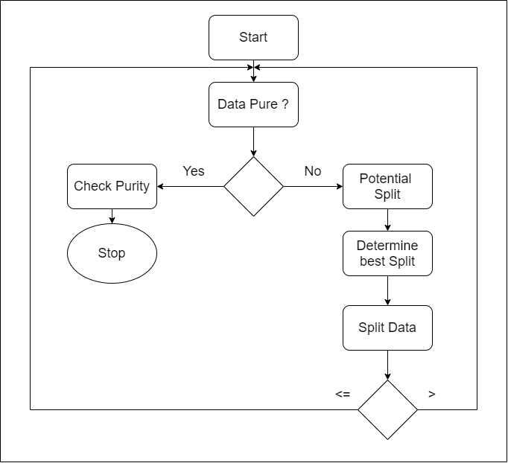
Decision Tree Logic
Helper Function:
Check Purity
Create Leaf
Potential Split
Split Data
Determine Best Split
Determine Column Type

Slide 30
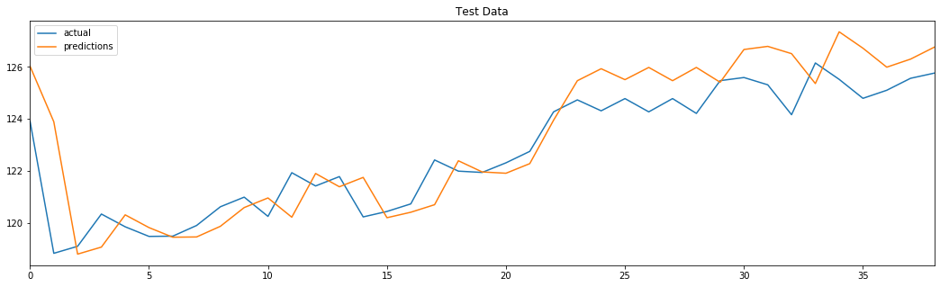
Results and Outputs
Accuracy | Random Forest Model
RMSE Value | 1.015
R2 Value | 0.7984
Sharpe Ratio | 1.36
Treynor Ratio | 0.8
Profit (%) | 0.6148 %
Hit Rate | 0.94

Slide 31
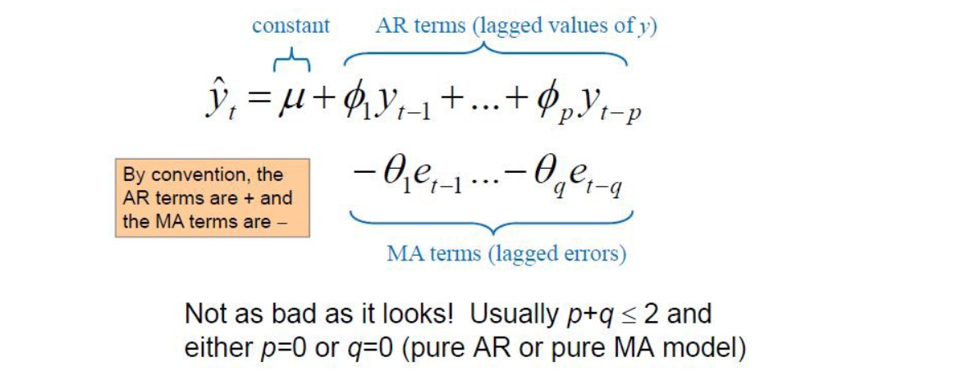
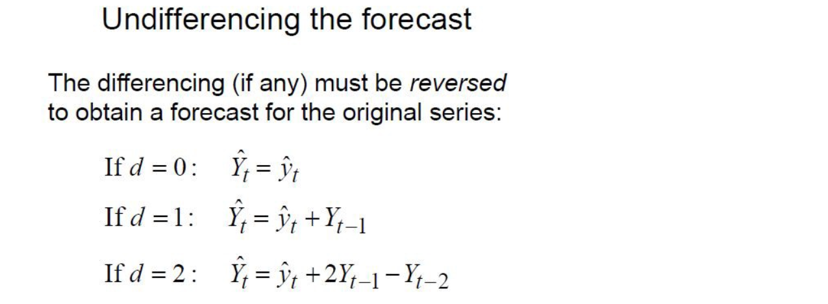
Time Series Forecasting Using ARIMA Model
Time Series: A time series is a series of data points indexed (or listed or graphed) in time order.
Time Series Forecasting: Time series forecasting is a technique for the prediction of events through a sequence of time.
ARIMA Model: ARIMA, short for ‘Auto Regressive Integrated Moving Average’ is actually a class of models that ‘explains’ a given time series based on its own past values, that is, its own lags and the lagged forecast errors, so that equation can be used to forecast future values.
Equations:

Slide 32
Basic Methodology
Data Loading
Data Modification as per requirement
Time Series Format ( Univariate Series)
Check for Stationary of the Series
Estimating & Eliminating Trend
Log Transformation
Moving Average
Exponentially Weighted MA
Eliminating Trend and Seasonality
First Order Differencing
Decomposing
Forecasting a Time Series: Partial auto correlation function (PACF) and Auto correlation function (ACF) (Estimating the parameter p and q in ARIMA model)
Grid Search to find the best Arima Model Order (p,d,q)
Model Prediction
Accuracy Test
Visualisation Plot
Back Testing

Slide 33
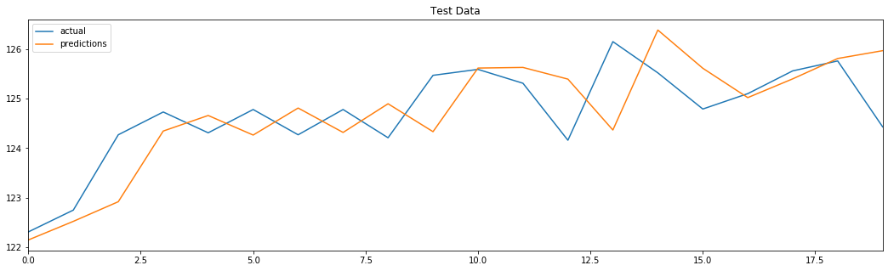
Results and Outputs
Accuracy | ARIMA Model
RMSE Value | 0.8165
R2 Value | 0.2256
Sharpe Ratio | 0.05
Treynor Ratio | 0.03
Profit (%) | 0.288%
Hit Rate | 1.0

Slide 34
Pairs Trading Algorithm
Underlying Principle:
Let’s say you have a pair of securities X and Y that have some underlying economic link, for example two companies that manufacture the same product like Pepsi and Coca Cola. You expect the ratio or difference in prices (also called the spread) of these two to remain constant with time. However, from time to time, there might be a divergence in the spread between these two pairs caused by temporary supply/demand changes, large buy/sell orders for one security, reaction for important news about one of the companies etc. In this scenario, one stock moves up while the other moves down relative to each other. If you expect this divergence to revert back to normal with time, you can make a pairs trade.
When there is a temporary divergence, the pairs trade would be to sell the outperforming stock (the stock that moved up )and to buy the underperforming stock (the stock that moved down ). You are making a bet that the spread between the two stocks would eventually converge by either the outperforming stock moving back down or the underperforming stock moving back up or both — your trade will make money in all of these scenarios. If both the stocks move up or move down together without changing the spread between them, you don’t make or lose any money.

Slide 35
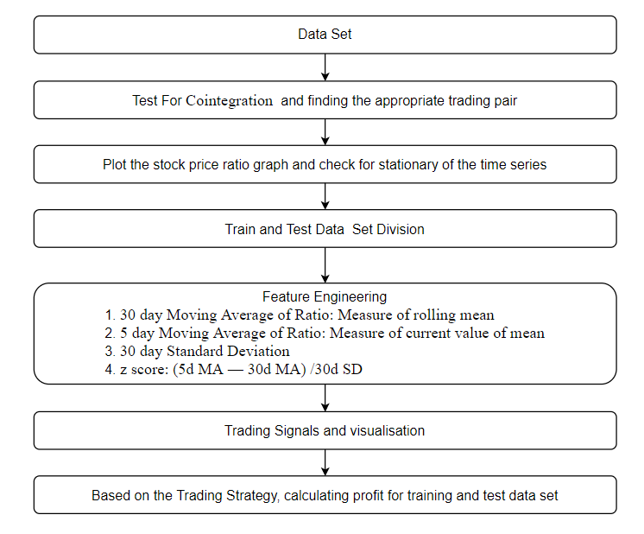
Basic Methodology
Getting data for all the stocks for which pairs trading needs to be checked
Test for Cointegration pairs
Finding the most appropriate pair
Finding the ratio and check for stationary of the series
Train and Test Data Set
Feature Engineering:
30 day Moving Average of Ratio: Measure of rolling mean
5 day Moving Average of Ratio: Measure of current value of mean
30 day Standard Deviation
z score: (5d MA — 30d MA) /30d SD
Finding the trading signals
Calculation of profit based on trading strategy for accuracy
Assumption: Stock Price Ratio is considered to be normally distributed in order to calculate Z-score
Result of the Algorithm:
Profit from training dataset: 135.85 USD
Profit from testing dataset: 111.05 USD

Slide 36
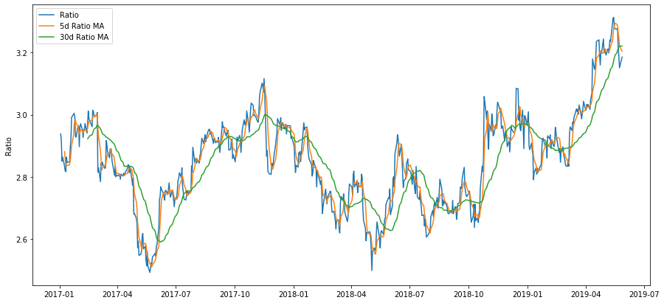

Slide 37
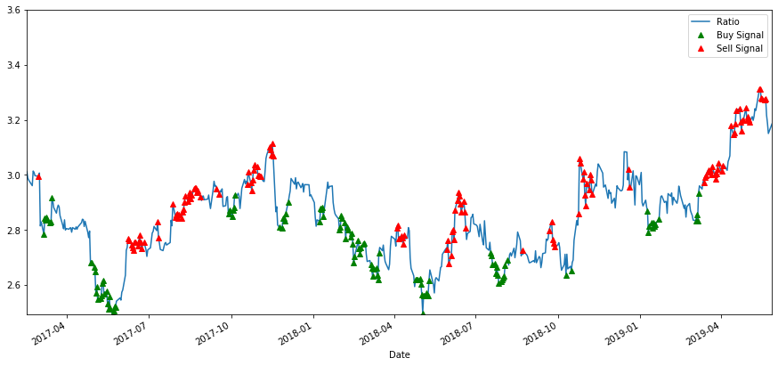

Slide 38
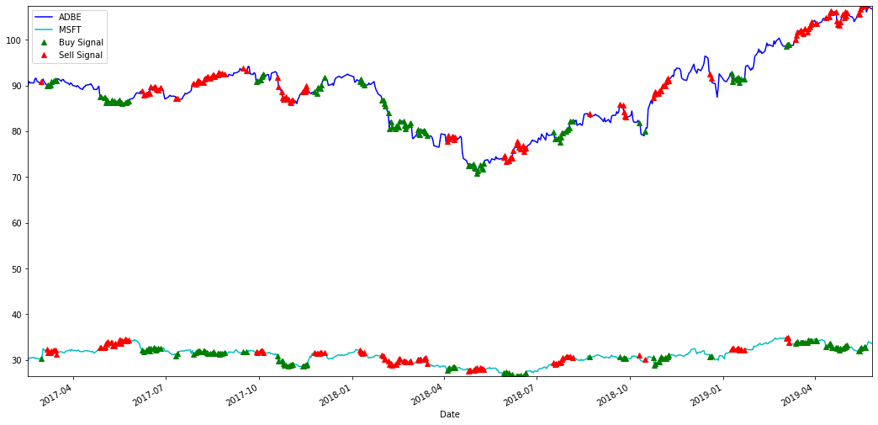

Slide 39
Garch Model
Definition:
Garch(p,q):Generalized Autoregressive Conditionally Heteroskedastic Models
It is a statistical model used in analyzing time-series data where the variance error is believed to be serially auto correlated.
The GARCH(1,1) model is:
σ²(t) = a*σ²(t-1) + b*e²(t-1) + w
Assumptions:
GARCH models assume that the variance of the error term follows an autoregressive moving average process.
P&G Data
High
Low
Open
Close
Average = (Open + 2x High + Close) / 4
Log Return = log(Opne(t) / Average(t-1))
Garch(1,1):
σ²(t) = a*σ²(t-1) + b*e²(t-1) + w
Y_Garch(t) = mean + σ(t)
Open(t) = exp(Y_Garch(t-1)) * Average(t-1)

Slide 40
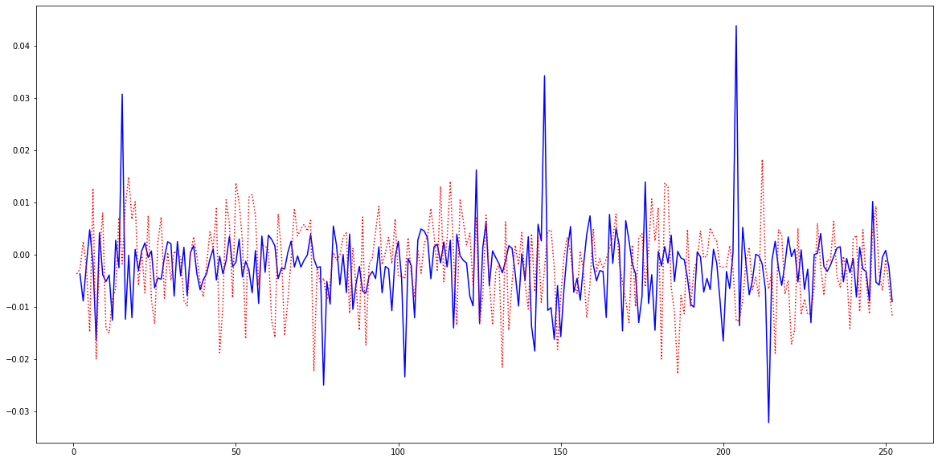
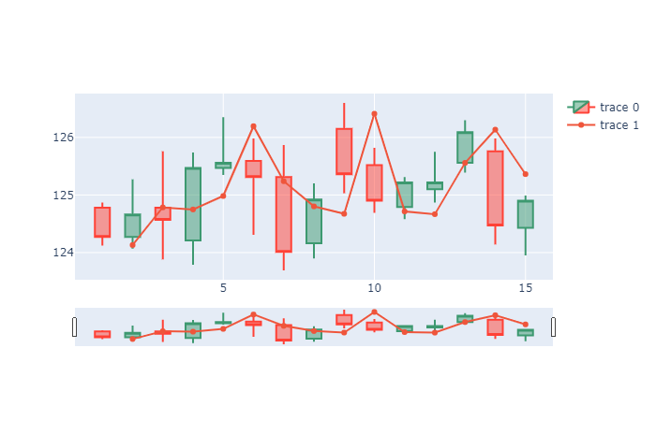
Plot for Garch Model Output
Log return (blue)
Garch Estimation (red)
Candlestick and Line Chart of Predicted Open

Slide 41
Result
Statistical Measure:
Backtesting:
R_square value: | 0.678
Root Mean Square Error: | 5.857
Sharpe Ratio | 0.955
Treynor Ratio | -0.692
Profit (%) | 0.437
Hit Rate | 1.0

Slide 42
Long Short Term Memory
P&G Data
Definition:
Long short-term memory is an artificial recurrent neural network architecture used in the field of deep learning. Unlike standard feedforward neural networks, LSTM has feedback connections. It can not only process single data points, but also entire sequences of data.
Assumptions:
LSTM assumes that the state at current time step depends on previous time step. This assumption constraints the time dependency modeling capability.
High
Low
Open
Close
LSTM Keras Package:
Layers : 3 [32 nodes, 16 nodes, 1(dense) nodes]
Activation Function : Linear
Loss : mse
Optimizer : adagrad
Epochs : 5
Batch_size : 1
Open price prediction for next day

Slide 43
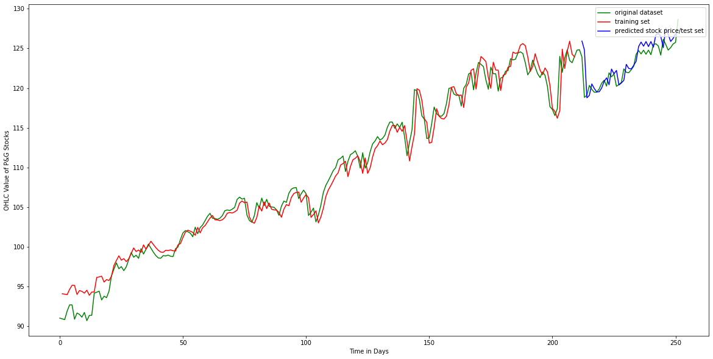
Plot for LSTM model Output

Slide 44
Result
Statistical Measure:
Backtesting:
R_square value: | 0.57
Root Mean Square Error: | 1.47
Sharpe Ratio | 1.27
Treynor Ratio | -2.92
Profit (%) | 0.49
Hit Rate | 0.91

Slide 45
Statistical Comparison of Models
 | LR | LR - CI | RF | ARIMA | Garch | LSTM
RMSE | 0.36 | 0.37 | 0.97 | 0.82 | 5.86 | 1.47
R_square | 0.84 | 0.84 | 0.82 | 0.22 | 0.68 | 0.57

Slide 46

Backtesting Development
Backtesting is the process of applying a trading strategy or analytical method to historical data to see how accurately the strategy or method would have predicted actual results.
Backtest includes:
Sharpe Ratio
Treynor Ratio
Average Profit
Hit Rate

Slide 47

Sharpe Ratio: It is measures the performance of an investment (e.g., a security or portfolio) compared to a risk-free asset, after adjusting for its risk.
here , Ra = Profit for P&G ;
Rb = Risk free rate (S&P 500 benchmark)
Sa > 1.0 :: considered acceptable to good by investors
Sa > 2.0 :: Very Good
Sa > 3.0 :: Excellent
Sa < 1.0 :: Sub-optimal
Sa < 0.0 :: Loss w.r.t. Benchmark
Average Profit: It is average profit gained in percentage per trade.

Slide 48


Treynor Ratio: It is a performance metric for determining how much excess return was generated for each unit of risk taken on by a portfolio.
here , ri = Profit for P&G ;
rf = Risk free rate (S&P 500 reference benchmark)
Bi = portfolio i's beta ;
T > 0 :: A positive ratio indicates that the investment has added value in relation to its risk.
T < 0 :: A negative ratio indicates that the investment has performed worse than a risk free instrument.
Hit Rate: It is defined as the percentage of the observations (in-sample) that is correctly predicted by the model.

Slide 49
Financial Comparison of Models using Backtesting
 | LR | LR - CI | RF | ARIMA | Garch | LSTM
Sharpe | 1.17 | 2.11 | 0.55 | 0.05 | 0.95 | 1.27
Treynor | 1.83 | 1.03 | 0.78 | 0.03 | -0.69 | -2.92
Profit (BPS) | 58 | 63 | 28 | 29 | 44 | 49
Hit Rate (%) | 100% | 100% | 95% | 100% | 100% | 91%

Slide 50
On a final note,
P&G is one of the few American businesses that has been deemed essential and can remain open. The Pennsylvania factory was told to stay up and running to continue to produce paper products and diapers. California issued a similar edict. Demand for paper products produced by P&G is so great that the company reopened an idle Georgia plant to meet the insatiable demand. The Procter & Gamble Company (PG) could offer safe haven against the pandemic storm in coming weeks, so PG stock should be an essential part of your portfolio.
We can offer different trading strategies based on regression, pairs trading, random forest and neural nets. Our quantitative strategies and machine learning model are developed from scratch so we have total control over result. Sum up, these can optimized portfolios.
Naive investment in P&G leads to average 4 bps of loss per trade. Our strategic investment technique can gain average 63 bps profit per trade with impressive success ratio and risk adjustment.
invest with us!

